Slide 1

Fun Reading Activities!

Slide 2
Starters!

Slide 3

Practise key words for your subject – scramble them up!

Slide 4
http://www.quizfreak.co.uk/can-you-crack-these-12-funny-countdown-conundrums/

Slide 5
Only connect – students connect word groups
http://www.bbc.co.uk/programmes/articles/2Z79DzzJY8w2R58bpftq14k/quiz

Slide 6
Quick fire pairs

Slide 7
Rules
Look at the following 10 descriptions of people’s roles in medieval times.
You are in 2 teams, green or blue. You have a card with a word on it & you have an opponent on the other team who has the same word.
Read the definition which pops up & shout out your word on the card before your opponent.

Slide 8
A boy learning a craft or trade

Slide 9
One of the most important Church jobs

Slide 10
An important nobleman

Slide 11
An important adviser to the king

Slide 12
A man who has promised to fight his lord’s enemies; a soldier on horseback

Slide 13
A clergyman of the Catholic Church

Slide 14
A person going specially to a holy place

Slide 15
A person who dies because of what he believes in

Slide 16
A person who betrays a king or country

Slide 17
A person who is not protected by the law; outcast

Slide 18
Running dictation

Slide 19
Rules
You are in 3 teams & you are going to do a running dictation relay race.
The teacher picks scribe captains (lead learners) & gives them a blank sheet of paper. A piece of text is on the other side of the room.
The rest of the team stand in a relay line & take turns running to the text at one side of the room memorising as much as they can of the text and running to the next person to say where they got up to & say to the scribe who writes down their sentence(s).
The winning team has the best accuracy rather than the fastest to finish.

Slide 20
Noughts & Crosses

Slide 21
Acceleration | Adaptation | Aerobic
Alchemy | Amphibious | Anomaly
Attenuation | Atom | Atmosphere

Slide 22
Slap

Slide 23
Acceleration | Adaptation | Aerobic
Alchemy | Amphibious | Anomaly
Attenuation | Atom | Atmosphere

Slide 24
Crossword

Slide 25
Kenya Jakarta Chicago Illinois
Columbia Honolulu Malia Harvard
racism maternal senate Michelle
McCain Democratic Clinton One
Sasha Barry Autobiography
Bush Goats

Slide 26
Washing line race

Slide 27
Microbes in action!
Fastest hands up!

Slide 28
Rules
First team to reach 3 points is the winner
Teacher or lead learner gives a definition and students put hands up to say the word
Choose first hand up
Students who have already answered sit out but help rest of their team.

Slide 29
Jigsaw groups https://www.youtube.com/watch?v=euhtXUgBEts
Group A: P26 & 27 Monks
Group B: P28 & 29 Nuns
Group C: P74 & 76 Education
Group D: P84 & 85 Married life
In your expert group come up with at least 10 bulletpoint facts for your topic
Practise a 30 second speech on another expert then go to your jigsaw group and perform your speech.

Slide 30
Homework!
Do-it-yourself questions & Flip learning
Summarize paragraph for rest of group or write comprehension questions using Blooms question starters.
Points given for the most challenging questions.

Slide 31
Memrise & Textivate
http://www.textivate.com/menu.php
hydecomm1 Pass0903
http://www.memrise.com/course/659896/zoom-espanol-1-5/garden/learn/

Slide 32
Cartoons create & re-order
http://www.linguascope.com/secure/students/comic/index.php
http://www.linguascope.com/secure/students/intermediate/activity.php?language=english&topic=society&activity=speechbubbles

Slide 33
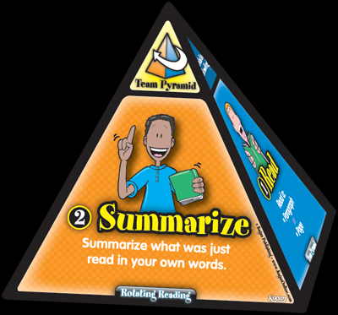
Kagan group reading strategies

Slide 34
Kagan – rotating reading
Team Pyramids – Rotating Reading (Class Set of 10)
Boost reading skills and comprehension!
When it’s time to read, the team places their pyramid on top of the team table. Each face of the pyramid corresponds to each teammate’s role during reading:
The first teammate reads a paragraph or page (depending on age and subject matter). The next teammate summarizes what was just read.
The next teammate makes connections between what was read and prior reading or knowledge.
The final teammate makes a prediction about what might come next. After a complete round, the team rotates the pyramid so that teammates rotate roles for every page or paragraph read. The pyramid is a terrific visual management tool to lead the team through a reading structure that promotes active listening, comprehension, and thinking.

Slide 35
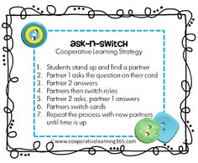

Slide 36
Kagan – reading strategies
Circle Triangle Square
Focussed Read
Jigsaw
Quiz quiz trade
Simultaneous round table
Text rendering
Wagon wheel
Rally read
http://www.kaganonline.com/free_articles/dr_spencer_kagan/281/Kagan-Structures-A-Miracle-of-Active-Engagement,3

Slide 37
Carousel learning/
Murder mystery games
Differentiated workbooks – gap-fill/reading comprehension/re-order/true false
Research stations
Hint or reference wall
Strict timings

Slide 38
Word Hunt
Builds skimming and visual recognition skills
Choose a section of text appropriate for students' ages. (The text might be a paragraph, a page, or more.) Provide students with a piece of scrap paper. Write four words on a chalkboard or chart; three of the words should come directly from the text; the fourth word should not appear in the text. As soon as the four words are revealed, have students skim the text, looking for the four words. When they know which word does not appear in the text, they write it on their papers and put down their pencils to signal they are done. How many students found the correct word?

Slide 39
Technology
&
reading

Slide 40
Reading song lyrics
Gap-fill
Re-order
https://www.youtube.com/watch?v=1qHTmxlaZWQ
https://www.youtube.com/watch?v=QIZTruxt2rQ
https://www.youtube.com/watch?v=2rjbtsX7twc
https://www.youtube.com/watch?v=GN5FEdlr3UA
https://www.youtube.com/watch?v=-KFUp7S6yn8

Slide 41

Skimming and Scanning…
Speed read or skim text to get the gist.
Scan text to find a specific piece of information.

Slide 42
How can you help your students skim and scan texts effectively?
Get them to look for bullet points, sub-headings and items made to stand out in bold.
Encourage them to look for lexical words.
Get students to read the topic sentence and scan the remainder of the paragraph.
Look for important information like names, dates or events.
When skimming, make sure they read the question carefully and understand what they are looking for.

