Slide 1
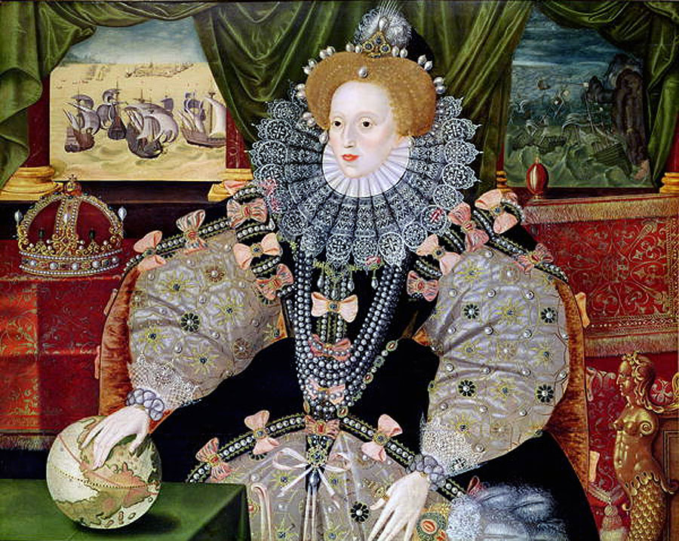
Notes:
History-Elizabeth I

Slide 2
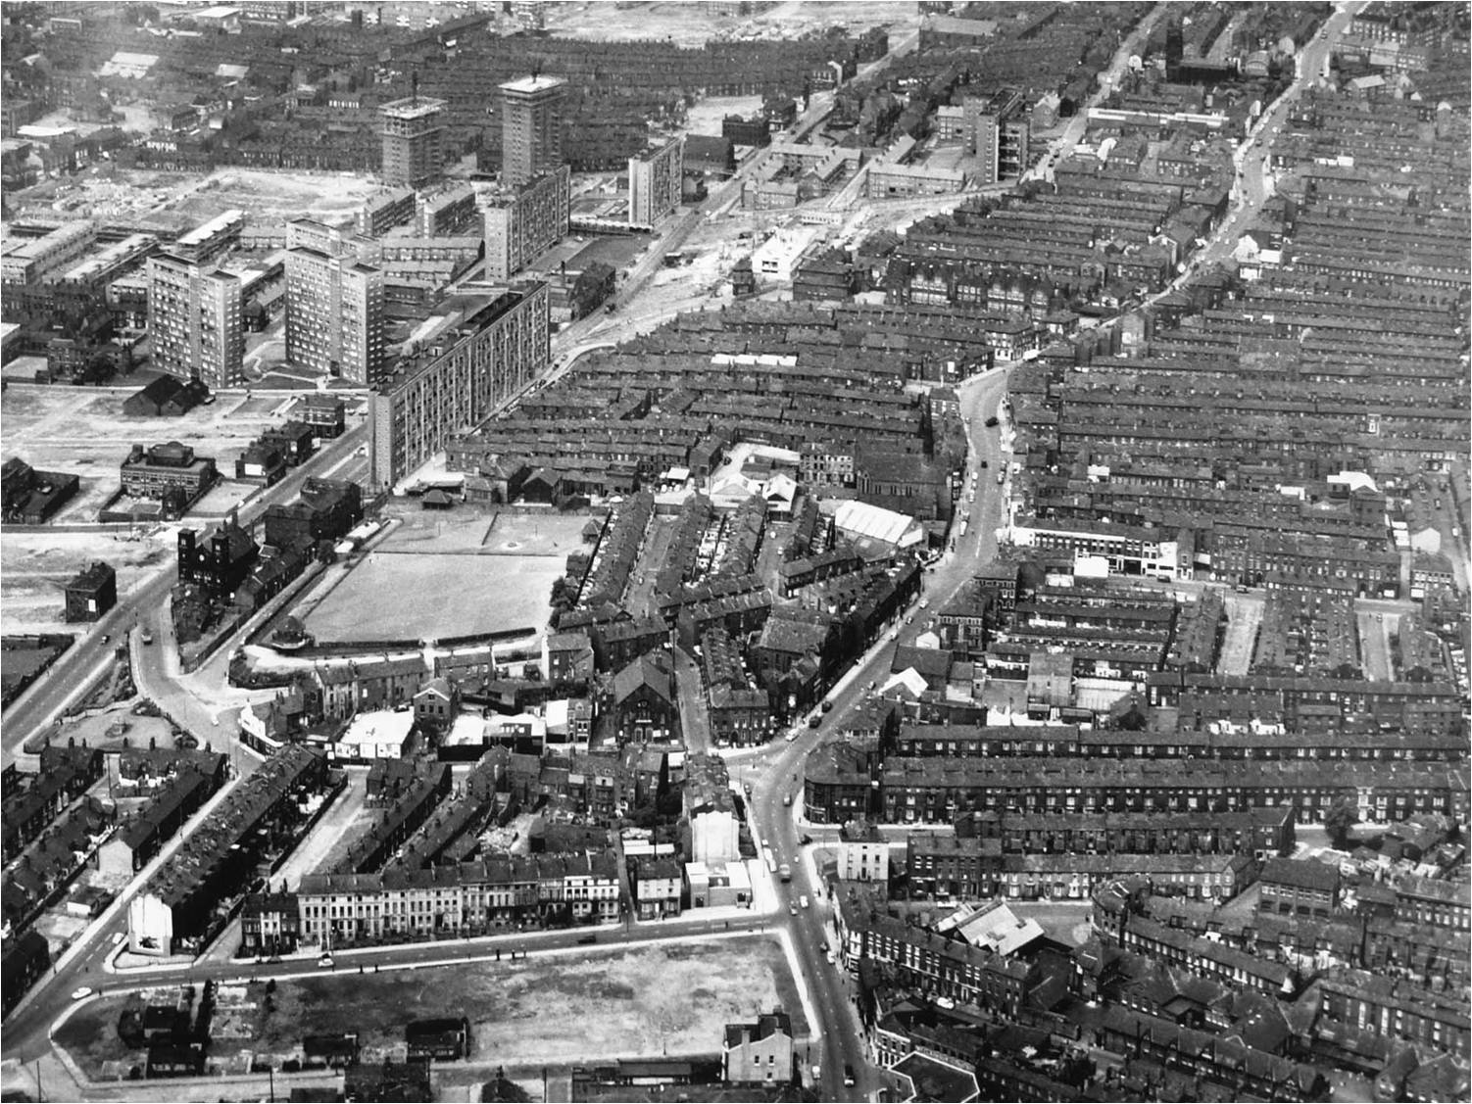
Notes:
Eng-blood brothers

Slide 3
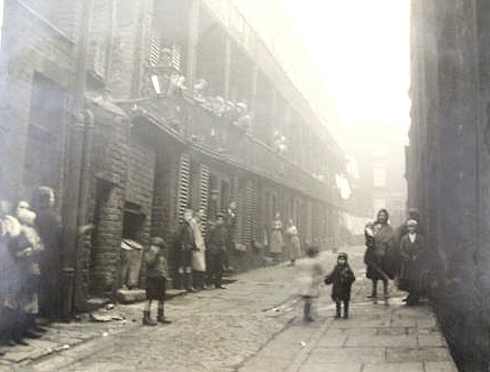
Notes:
Eng-Blood brothers

Slide 4
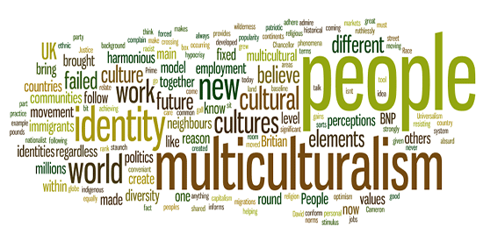
Notes:
RE/Citizenship multiculturalism/community

Slide 5
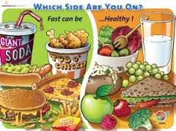
Notes:
Catering healthy eating

Slide 6
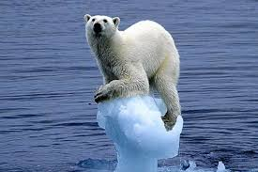
Notes:
Geog/Science global warming

Slide 7
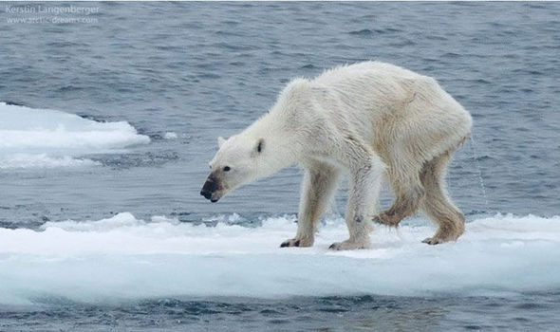
Notes:
Geog/Sci Global warming

Slide 8
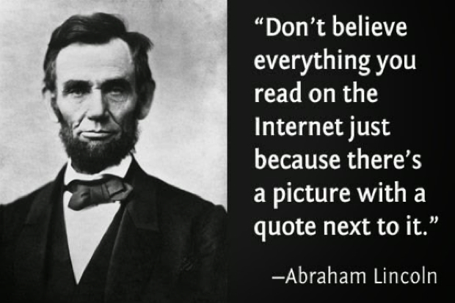
Notes:
IT- trustworthiness of the Internet

Slide 9


Notes:
Maths-Geometry

Slide 10
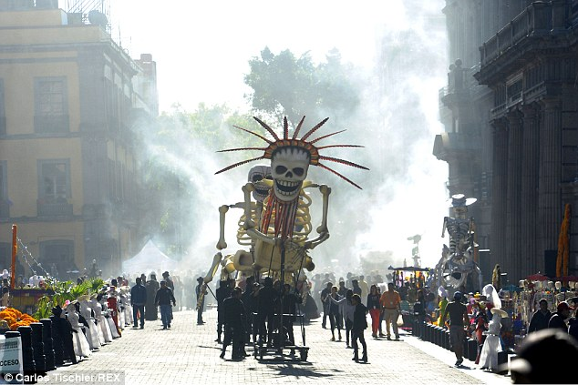
Notes:
MFL/ART Carnival of the dead

Slide 11
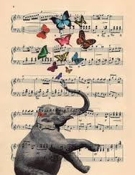
Notes:
Music-animals

Slide 12
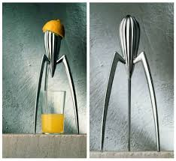
Notes:
DT Iconic products

Slide 13
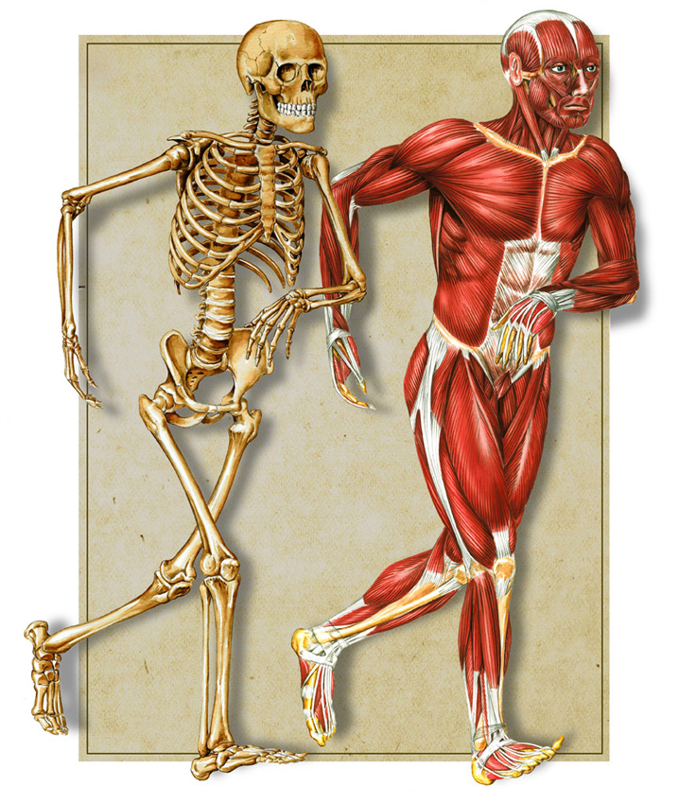
Notes:
PE/SCIENCE Bones/Muscles

