Slide 1
Making Thinking Visible
https://www.youtube.com/watch?v=5WSTcVDwH3s
Notes:
Video 4 minutes outlines John Hattie 8 mindframes – golden rules for educators.

Slide 2
John Hattie Visible Learning
The principle is “visible teaching and learning.”
Hattie stresses that he is telling us nothing new!
When the teaching is visible the student knows what to do and how to do it.
When the learning is visible the teacher knows if learning is occurring or not.
In successful classrooms, both the teaching and learning are visible.
Teaching and learning are visible when the learning goal is not only challenging but is explicit. Furthermore, both the teacher and the student work together to attain the goal, provide feedback, and ascertain whether and how the student has attained the goal.
Hattie analysed the effects of different teaching and learning methods. His evidence shows that the greatest effects on student learning come when not only the students become their own teachers (through self-monitoring, and self-assessment), but the teachers become learners of their own teaching.
How can we/do we make teaching visible? | How can we/do we make learning visible? | How can teachers become learners of their own teaching?

Slide 3
How can we make learning visible? It’s a big topic, but one way is through making the ‘thinking’ visible.
What ‘thinking’ happens in your lessons? How do you know?
On the back of your info sheet, write down your responses to this question.

Slide 4
What is making thinking visible?
Hattie outlines eight mind frames. We will focus on three of these mind frames in particular as we look at making learning visible. These are: talking about learning (beyond bloom), dialogue over monologue (understanding), and the language of learning.
The idea of visible learning is to externalise the processes of thought so that learners get a better handle on them (metacognition or ‘thinking about thinking’).
It’s about establishing a positive, engaged and thoughtful culture of learning in classrooms using a range of strategies.
When thinking is made visible, we not only get a window into what students already understand but also how they understand it. This gives us the opportunity to plan lessons that will take students learning to the next level and enable continued engagement with the ideas being explored (learners become their own teachers and teachers become learners of their own teaching).
https://www.youtube.com/watch?v=QkGiplxftYA
https://www.youtube.com/watch?v=z-Vu_CqyEpo
As you watch the clips, what do you notice that provides evidence of visible learning?
Notes:
Red bit is if the first media clip is used on the first slide. Youtube clip on this slide 1st = 2 minutes. Primary school teacher demonstrates visible thinking. 2nd = Inference game. Primary school teacher activity – what do you notice that provides evidence of visible learning.

Slide 5
Why is making thinking visible important?
Just knowing ‘stuff’ has now become the focus of education through examinations and constant assessment.
But it’s ‘thinking with’ that’s important, as what they learn becomes more meaningful to their lives.
Learning has become ‘training’ rather than ‘thinking’.
When the ‘thinking’ component is missing, the learning is likely to be missed as well (Ritchart 2011)

Slide 6
Strategy 1:
Questioning: Beyond Bloom!
What questions do you tend to ask in your everyday teaching practice?
Brainstorm your ideas as a group.

Slide 7
Beyond Bloom…
Beyond Bloom!
Questioning has long been a focus in education. Bloom is usually used as a template for teachers to ask better questions.
However using Bloom can be difficult to use in the spur of the moment, although great for observations!
So what about questioning in our everyday teaching…and how can we use questioning to make thinking visible in the classroom?

Slide 8
1) Model our interest in the topic!
Ask authentic questions-questions that we don’t even know the answer to!
Also great for Growth Mindset as it’s fostering a community of enquiry and allows the students to also see us as learners.

Slide 9
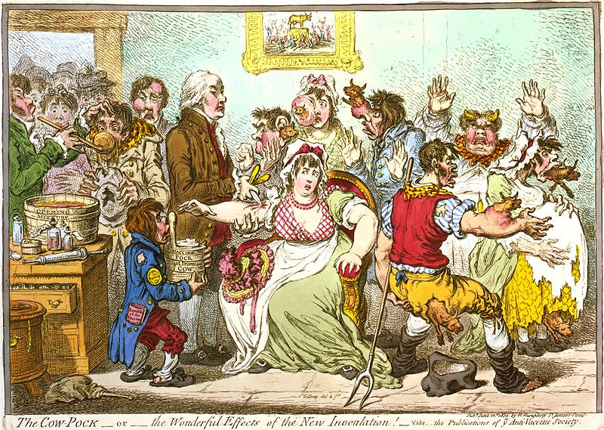
What’s the story?
Notes:
Teachers can discuss and complete the worksheet.

Slide 10
2) Constructing understanding
Allow students to think beyond:
Case Study: Science class learning about the senses. Teacher wants them to know what they are but to also think about what they’re learning. Objects are disguised in a box and students need to touch:
You have a go!!!
What did you feel?
What did you think about what you felt?
What are you left wondering about the object given that you were only able to feel?

Slide 11
Less teacher talk and more listening!
“Some teachers help students think deeply about what they are learning through asking difficult questions and requiring students to analyse and evaluate information, however not all staff use this strategy to best effect”. (Ofsted 2014)
As we all know from our Ofsted feedback pupils need to show that they are thinking!
One of the findings of Hattie is that the proportion of teacher talk to listening needs to change to less teacher talk and more teacher listening! Indeed, pupil dialogue and debate is an ideal way to ensure this AND make learning visible.
Hattie found that most teacher talk, even when it calls for a student response, fosters lower-order learning and low engagement.
In addition, a lot of teacher talk is aimed at controlling behaviour so the teacher can continue talking!
Part of why we need teachers to talk less is because it is important for them to listen. Listening allows the teacher to learn about the students’ prior achievement, understanding and cognition. Listening allows for true depth of thinking and can shape lessons to become more meaningful, and requires genuine dialogue between the teacher and student.
Moreover, listening makes the THINKING and LEARNING visible.
The good news is that our pupils are more than happy to have a go:
Relationships within classes are strong and students are respectful of the contribution of others in the class. (Ofsted 2014)

Slide 12
3) Facilitating & clarifying thinking: Language of Learning
“What makes you say that?”
The best way to make thinking visible in every lesson.
Leads to deeper and more meaningful discussion & learning.
Clarifies the learners own thinking
Student becomes active in constructing their own understanding.
Could train students to ask students when doing activities like think, pair, share, P4C, discussion activities etc.
Notes:
See clarifying thinking pair and share sheet – will this work?

Slide 13
Strategy 2:
Think, Puzzle, Explore
What do you think you know about this topic?
What questions or puzzles do you have?
How can you explore this topic?

Slide 14
Step 1:
Use at the beginning of a topic
Tell students the topic they are studying e.g. Structure of the Earth.
Show students a stimulus, could be a picture, an artefact, a quote, a code etc.
Ask students to complete section ‘what they think they know’ about the topic and the image. Ask each student to write down at least one thing.

Slide 15
Step 2:
Discuss students responses about what they think they know-these can be recorded on board as a visual aid for students. Capture all comments including misconceptions!
Step 3:
What kind of questions do you have about the topic/image?
Write these down in the puzzle box. Make sure everyone writes down at least one thing! Could all have a different coloured pen perhaps?

Slide 16
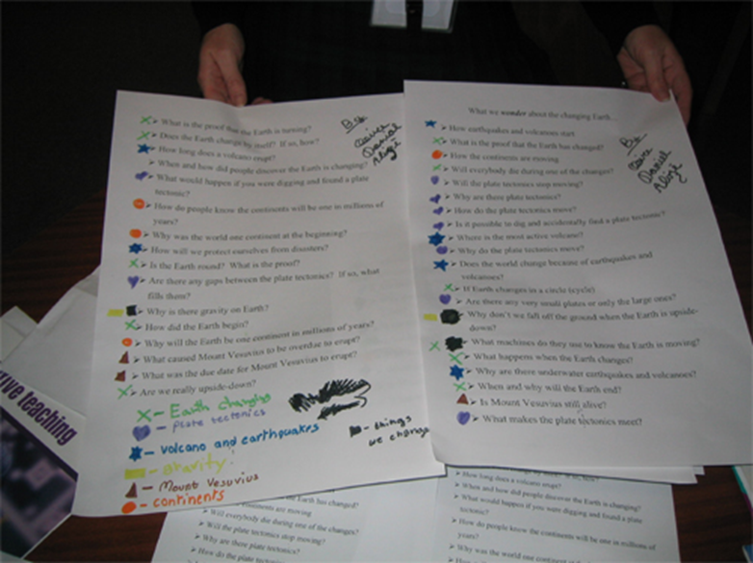
Step 4
Analyse the different kinds of questions that they have wondered about and identify emerging categories.

Slide 17
Step 5:
Describe the category and give each one a title.
Step 6:
Use the categories to explore the topic in the depth. Students can create a project or this can inform your planning.

Slide 18
Plenary
Plenary
Look back at the first task we did: “What thinking happens in your lesson?”
Using the red pens, could you develop any of the ideas you wrote down so that visible thinking takes place?
Think about this to help inform your planning, perhaps you could select one topic where the students take complete ownership and see how it goes ☺

