Slide 1
1
2
3
4
5
6

Slide 2
7
8
9
10
11
12

Slide 3
13
14
15
16
17
18

Slide 4
Kagan
Cooperative Learning Structures

Slide 5
Why?
Strategies to help empower teachers to dramatically increase student achievement, improve social skills, and reduce discipline problems in an atmosphere of fun and learning.

Slide 6
Active
Cardio boosts blood flow to the brain, which delivers much-needed oxygen (the brain soaks up 20 percent of all the oxygen in your body).
This helps the brain focus and retain information better

Slide 7
The Task
To make Cooperative learning a part of every lesson. Instead of spending ages on specially designed episodes, do two minute activities like ‘Timed, Pair, Share or RallyRobbin.
You do not have to throw out existing lessons or plans but just tweak them by adding different ways of making them more engaging and interactive.

Slide 8
Cooperative Learning- the difference
There is a massive difference between cooperative learning and working in a group. Anyone who has worked in an unstructured group will know too well the normal traits:
Some students doing all the work
Some doing nothing
Some working on their own
Some dominating the group and taking over etc.
Kagan and its strategies help provide a structure for effective cooperative learning. To ensure all students participate, held accountable for their contribution and learnings, are maximally engaged and work together towards a shared team goal.

Slide 9
7 key Concepts
Structures
Teams
Management
Classbuilding
Teambuilding
Social Skills
PIES
Structures- the strategies used in classrooms. The relationship between teacher, students and content. The important part with Kagan is they have student to student interaction as an integral part of the learning process.

Slide 10
2) Teams
Teams- Cooperative learning teams consist of four members. This allows pair work, this doubles as active participation, opens up twice as many lines of communication. Should have a strong positive identity.
4 types.
Heterogeneous Teams. Mixed. Ability, gender, ethnicity. Try to include mixed ability. Maximizes positive peer tutoring. If all students on team has exactly same knowledge and skills, they would have nothing to learn from each other. To a degree the greater the heterogeneity the greater the learning potential.
Homogenous Teams. Formed on shared student characteristic. Same ability level. Shared interests. i.e. researching types of animals
Random Teams. Luck of the draw. This could be done by handing students a number and they stand up and mix in the classroom repeatedly until teacher calls ‘FREEZE’. Great way to create excitement and promote classbuilding. This is not advisable for a long term option as lowest achievers could be in same team for a long time.
Student Selected Teams. Self explanatory. Shared interests with friends. Again not a frequent or long term solution.
All Types of teams should be used but Heterogeneous teams is the more stable base and ensures one relatively high achiever to improve tutoring, equalize teams status avoiding ‘winner’ and ‘loser’ teams. Not competitive, but engaging.
Change every 6 weeks.

Slide 11

Shoulder Partner
1
2
3
Face Partner
4
Face Partner
Shoulder Partner

Slide 12
TEAMBUILDING
BLIND CATERPILLAR
RoundRobin- When was the last time you belly laughed ☺
Any activity which is fun, non academic and all can participate

Slide 13
Structures
Teacher A- traditional instruction. Asks a question to the class, allows those who want to answer to raise their hands, calls a volunteer and then responds to answer. (what about the ones eager but don’t get called, or the ones who hide)
Teacher B- Group Work. Often will say something like “talk it over in your groups” or “turn to a partner and discuss it”
Teacher C- Structures. Chooses from a variety of structures for example RallyRobbin to have partners take turns in generating an oral list. Then use Numbered Heads Together for review, to have students share and improve their answers with team mates, then have individuals share with class.

Slide 14
THINK TIME!!
Improves a quality response
Encourages more students to participate

Slide 15
Rally Robbin/ RoundRobin
Students take turns responding orally.
RoundRobin take turns in teams, RallyRobin take turns with partners.
1) Teacher poses a problem to which there are multiple possible responses or solutions, and provides think time
2) Students take turns stating responses
Describe yourself? One word answers!

Slide 16
Rally Robin/RoundRobin
English- famous writers
Science- famous scientists
DT/Food- famous designers/chefs
Humanities- famous deities/archaelogists

Slide 17
Variations on Robin Structure
AllWrite Round Robin- students each record each answer on their own paper.
AllWrite Consensus. During RoundRobin, after reaching consensus, students record each answer on their own paper.
Timed RoundRobin- Each student shares in turn for specified time
Think-Write-RoundRobin. Students think about their response, then independently write it down before the RoundRobin
Single RoundRobin- The team does just one round of sharing, each teammate getting one turn.

Slide 18
Rally Coach
Partners take turns, one solving problem while the other coaches.
Partner A solves the first problem
Partner B watches, listens, checks, coaches if necessary, and praises- the role of the coach
Partner B solves the next problem etc.

Slide 19
FAN-N-PICK
1) Student one holds question cards in a fan and says “Pick a card”
2) Student 2 picks a card, reads question aloud, and allows five seconds of think time.
Student 3 answers question.
Student 4 responds to answer.
If question has a right or wrong answer, they check it and other praises or tutors
For questions with no right or wrong answer, student 4 praises and then paraphrases the thinking that went into the answer.

Slide 20
Fan and Pick
https://www.youtube.com/watch?v=_tc5Y4Y0Cvw

Slide 21
Q and A
Q and A
Q and A
What is the capital of Iceland?
A- Brasilia
2) What are the three primary colours?
A- Red, blue, yellow
3) What do you find most frustrating in our professions?
No answer- thank them, paraphrase to the group what they said.
4) What has made you smile or laugh today? No answer- thank them, paraphrase to the group what they said.
What is the capital of Iceland?
A- Brasilia
2) What are the three primary colours?
A- Red, blue, yellow
3) What do you find most frustrating in our professions?
No answer- thank them, paraphrase to the group what they said.
4) What has made you smile or laugh today? No answer- thank them, paraphrase to the group what they said.
What is the capital of Iceland?
A- Brasilia
2) What are the three primary colours?
A- Red, blue, yellow
3) What do you find most frustrating in our professions?
No answer- thank them, paraphrase to the group what they said.
4) What has made you smile or laugh today? No answer- thank them, paraphrase to the group what they said.
Q and A
Q and A
Q and A
What is the capital of Iceland?
A- Brasilia
2) What are the three primary colours?
A- Red, blue, yellow
3) What do you find most frustrating in our professions?
No answer- thank them, paraphrase to the group what they said.
4) What has made you smile or laugh today? No answer- thank them, paraphrase to the group what they said.
What is the capital of Iceland?
A- Brasilia
2) What are the three primary colours?
A- Red, blue, yellow
3) What do you find most frustrating in our professions?
No answer- thank them, paraphrase to the group what they said.
4) What has made you smile or laugh today? No answer- thank them, paraphrase to the group what they said.
What is the capital of Iceland?
A- Brasilia
2) What are the three primary colours?
A- Red, blue, yellow
3) What do you find most frustrating in our professions?
No answer- thank them, paraphrase to the group what they said.
4) What has made you smile or laugh today? No answer- thank them, paraphrase to the group what they said.

Slide 22
Jot Thoughts- “cover the table”
Teacher names a topic, sets a time limit and provides think time . One idea per slip of paper/post it
Q- What makes an effective teacher?
Cover the table
No slips overlap

Slide 23
Now organise ready to present to the group

Slide 24
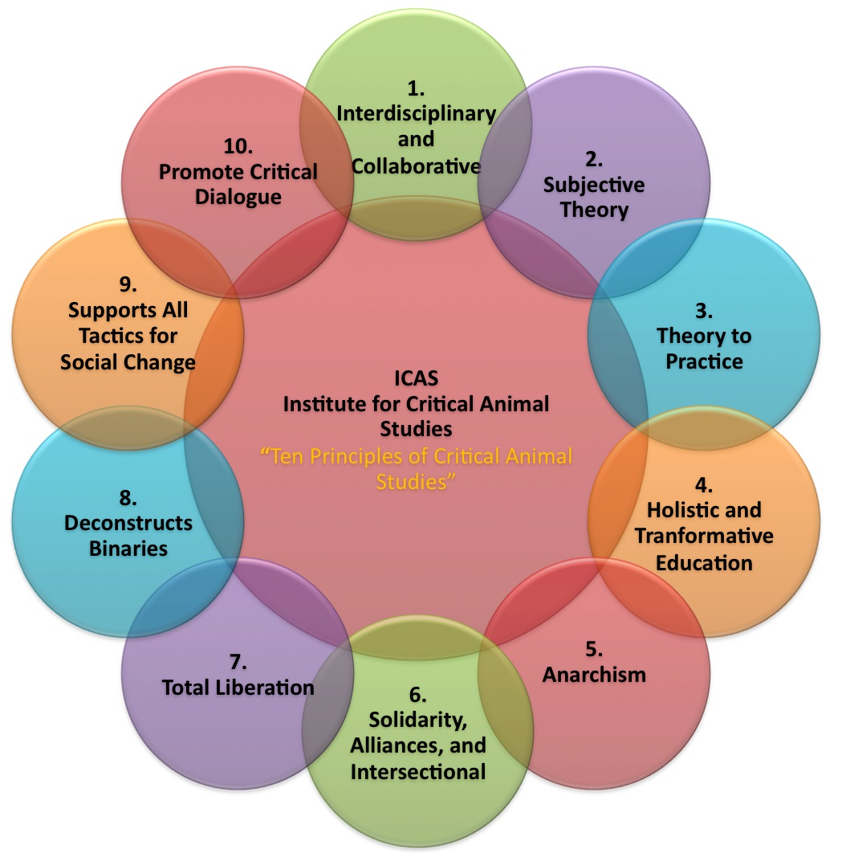
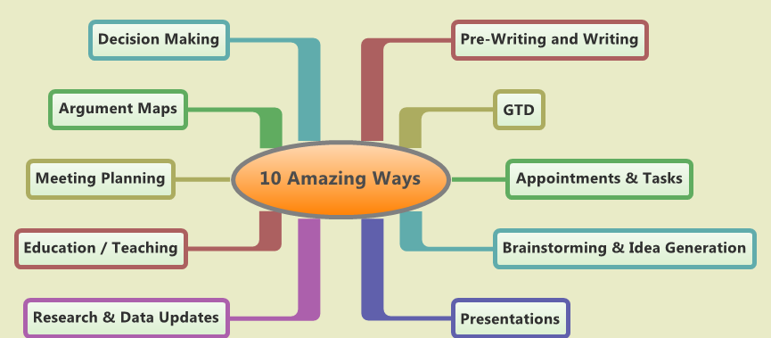

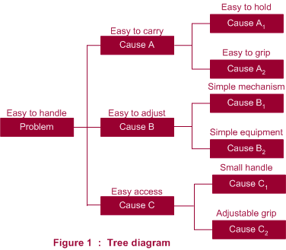
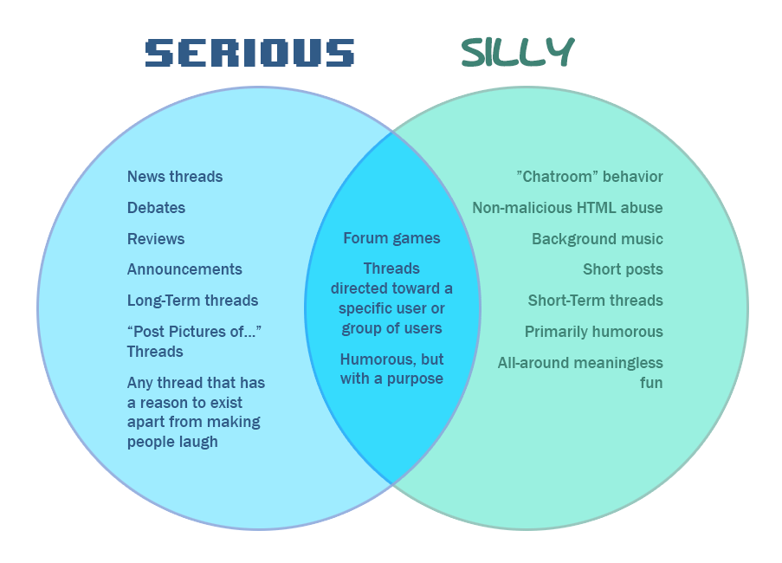
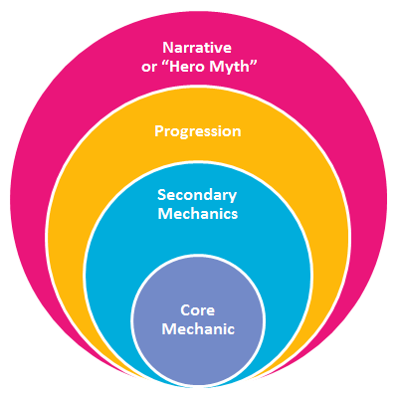
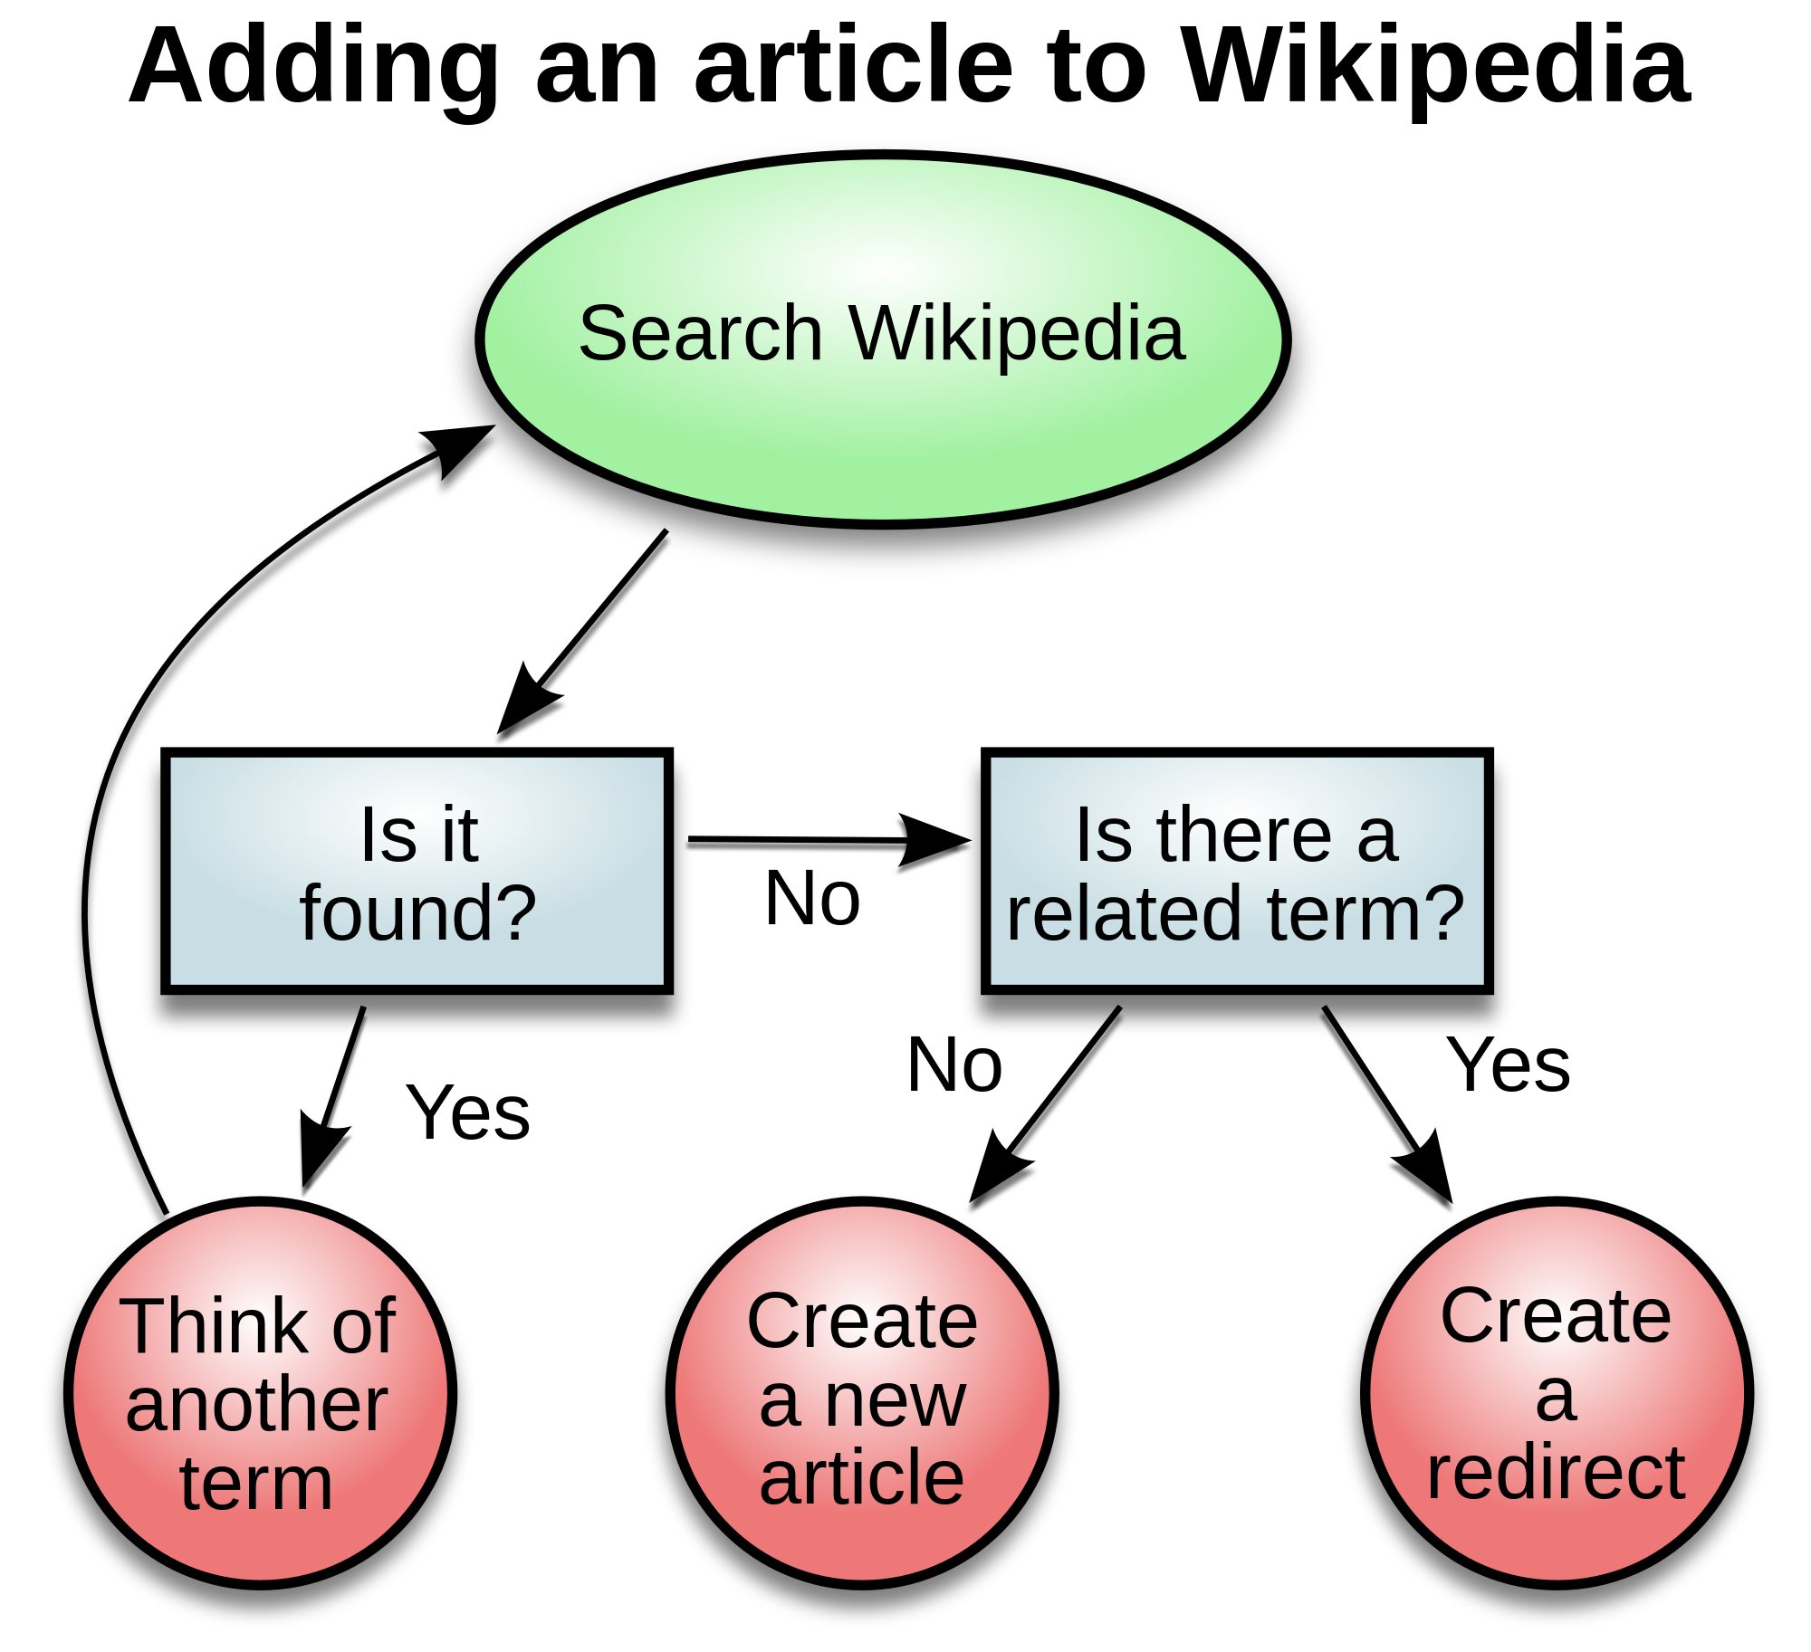
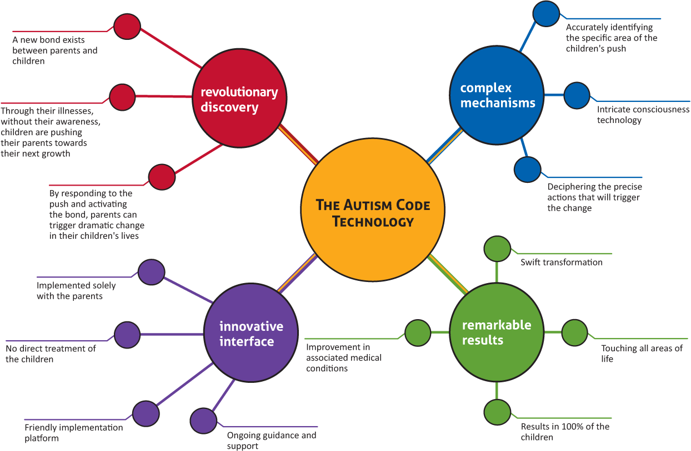

Slide 25
Round Table Consensus.

Slide 26
Debate Questions
DT- Why is Technology important to everyday society?
English- How important is Shakespeare to modern day literature?
Humanities- Should the Death Penalty be brought back in to the UK?
Science- Is Social Media helping Science and Technology to progress?

Slide 27
TIMED PAIR SHARE
In pairs, students share with a partner for a predetermined time while the partner listens. Then partners switch roles.
Teacher announces a topic, states how long each student will share, and provide think time
In pairs, Partner A shares; Partner B listens.
Partner B responds with a positive gambit.
Partners switch roles.
Copycat response gambits
Thanks for sharing!
You are interesting to listen to!
Complete the sentence gambits
One thing I enjoyed listening to you was ….
I enjoyed listening to you because ….
Your most interesting idea was …..
Topic- If you had any wish, what would it be and why?

Slide 28
Stand up, Hand up, pair up
When I say, you will “stand up, hand up and pair up”.
Students stand, keep one hand high up in the air until they find the closest partner who is not a teammate. Students do a “high five” and put their hands down.
Teacher now asks question or gives assignment and relevant think time
Partners interact using : RallyRobbin
Timed Pair Share

Slide 29
Quiz Quiz Trade
https://www.youtube.com/watch?v=kDEYLiPTKQE
Classroom example- https://www.youtube.com/watch?v=Q1GGBNBe0oc

Slide 30
Give one, get one
https://www.youtube.com/watch?v=Oh_90rNyCB0

Slide 31
Take a stand
https://www.youtube.com/watch?v=8ZUSqjHwa6s

Slide 32
Gallery Walk
https://www.youtube.com/watch?v=pSt5echeRrM
TASK- In your groups, create an information sheet to either:
Promote your subject as the best in school
Explain the importance of your subject
Promote the best parts of your subject to our students.
Every person in the group should have a role and contribute the poster.
Include imagery, colour, information, persuasive language etc.

Slide 33
Carousel Brainstorm
https://www.youtube.com/watch?v=zZxaS7v1-jo

