Slide 1
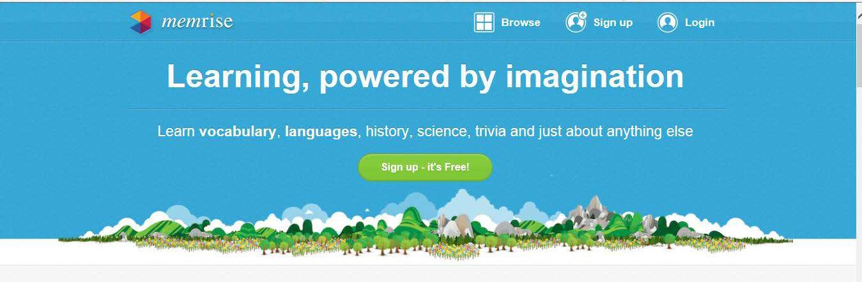


How to use Memrise to boost subject-specific literacy.

Slide 2
What is Memrise?
Memrise is a free website. No subscription necessary.
Any key concept, vocabulary or idea can be learnt and most importantly, retained by frequently using the scientifically designed memorisation activities.
Community of thousands – creating courses in a variety of subjects and topics.

Slide 3
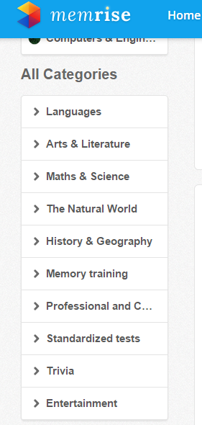
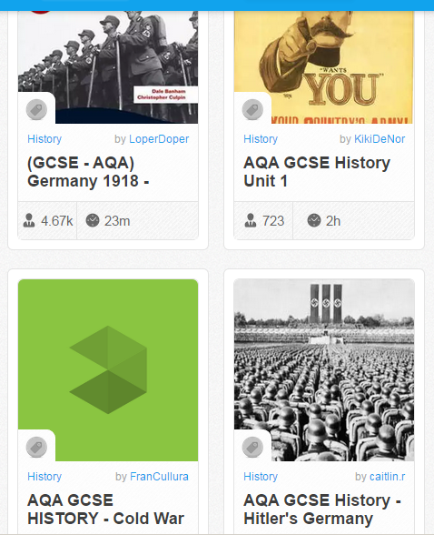
Easy to search for particular unit or topic.
Variety of subjects and topics.
No. of people learning the course / how long it takes to complete all vocabulary / concepts.

Slide 4
Why use memrise?
Easy to set up – hundreds of courses have already been created by members and are available to use.
Students earn points the more they practise and can view how their classmates are doing on the group leader board – great for competitions!
Stats section allows you to view how long students have been practising and how much progress they have made through the whole course.
It works! Pupils retain content – great for ‘flipped learning’.
Notes:
Ready-made courses available in a variety of topics / subjects. Alternatively, you can create your own course and content easily, share it with others in the department and allow them to contribute to it too.
Pupils can ‘follow’ each other like Twitter and create their own profiles – element of social media but no ‘chat’ option available.
Stats section on next slide – more detailed breakdown, no more homework excuses!
Pre-learning of vocabulary or concepts before starting a new topic can save time in class or can be used to consolidate learning done in class previously.

Slide 5
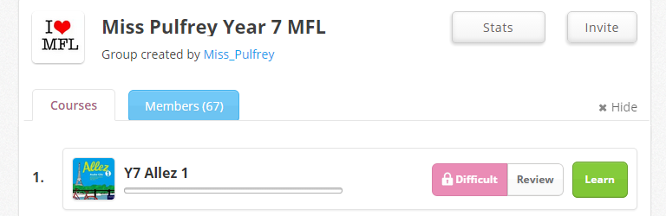
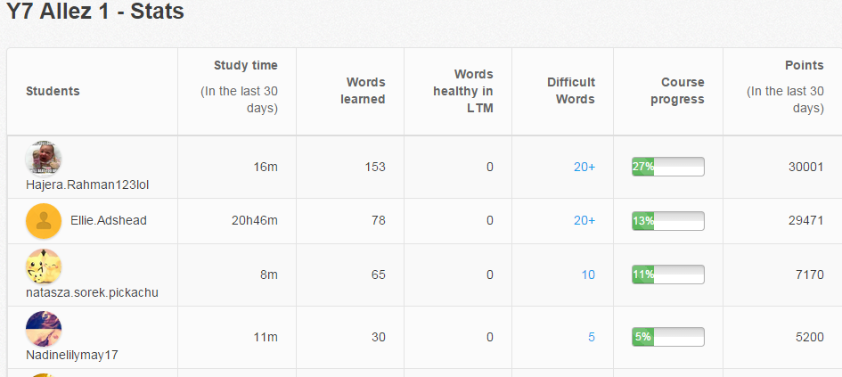
Stats to track students’ progress.
v

Slide 6



